Slide 1
1st class: Where to find experimental protein structures and how to view them
PDB and its derived databases + many other resources.
Mol. graphics: PyMOL, ChimeraX, etc.
2nd class: How to model proteins for which there are no structures
Homology Modeling exemplified with SwissModel / Ab initio with AlphaFold in ColabFold.
Contests like CASP, CAMEO, CAPRI
What to look at in protein model?
What can we infer safely or not? Are certain details well supported? Do they matter?
Today: Modeling beyond protein structures themselves
Small molecules
Canonical protein structures
Protein-X complexes
Membranes, micelles, liposomes
Glycans, polymers, etc.
Molecular modeling / simulations

Slide 2
Modeling biomolecules and assemblies other thank “just” whole proteins
CLASS 3
Small molecules: pockets, small molecules in 3D, docking, virtual screening
Canonical protein structures (secondary structures, coiled coils, …)
Protein-X complexes (AF-multimer vs. surface predictions, HADDOCK, and other docking tools)
Membranes, micelles, liposomes
Glycans, polymers, etc.
Molecular modeling / simulations
https://go.epfl.ch/bio-643

Slide 3
Small molecules
Databases: PubChem (NCI), ZINC
Build online: https://chemapps.stolaf.edu/jmol/jsmol/hackamol.htm
Build into X-ray diffraction maps: with COOT
Local experts on cheminformatics:
* V. Zoete @ UNIL https://www.molecular-modelling.ch/swiss-drug-design.html
* Luc Patiny @ EPFL’s ISIC (Chemistry IT & Data management platform, “cheminformatics”).
- https://cheminfo.github.io/team
- https://ms.epfl.ch/applications/ (mass spec small mols to large biomol w/MS fac.)
- https://www.nmrdb.org/new_predictor/index.shtml?v=v2.138.0 (small mol NMR w/NMR fac.)
Dock with data: HADDOCK
Blind docking (predictions): AutoDock, AutoDock Vina, etc. + commercial programs like FlexX, Glide, etc.

Slide 4
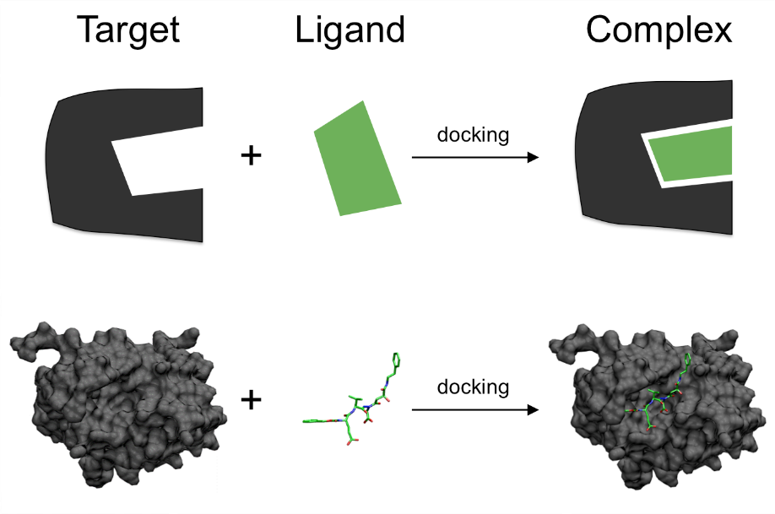
Small molecule docking
Core method:
Sample relative position & orientation between target and ligand
Sample the torsions of the ligand (plus possibly of the protein)
Score the ligand-target poses and compare with decoys
Very difficult, with expertise critical as well as data about known binders and non-binders for each system.
But undergoing strong developments given the $$$ relevance for pharma!
CAREFUL: Docking scores don’t mean anything if not done in the context of + and - controls (“decoys”) !!!
TL;DR: For serious blind docking / virtual screening go to an expert group

Slide 5
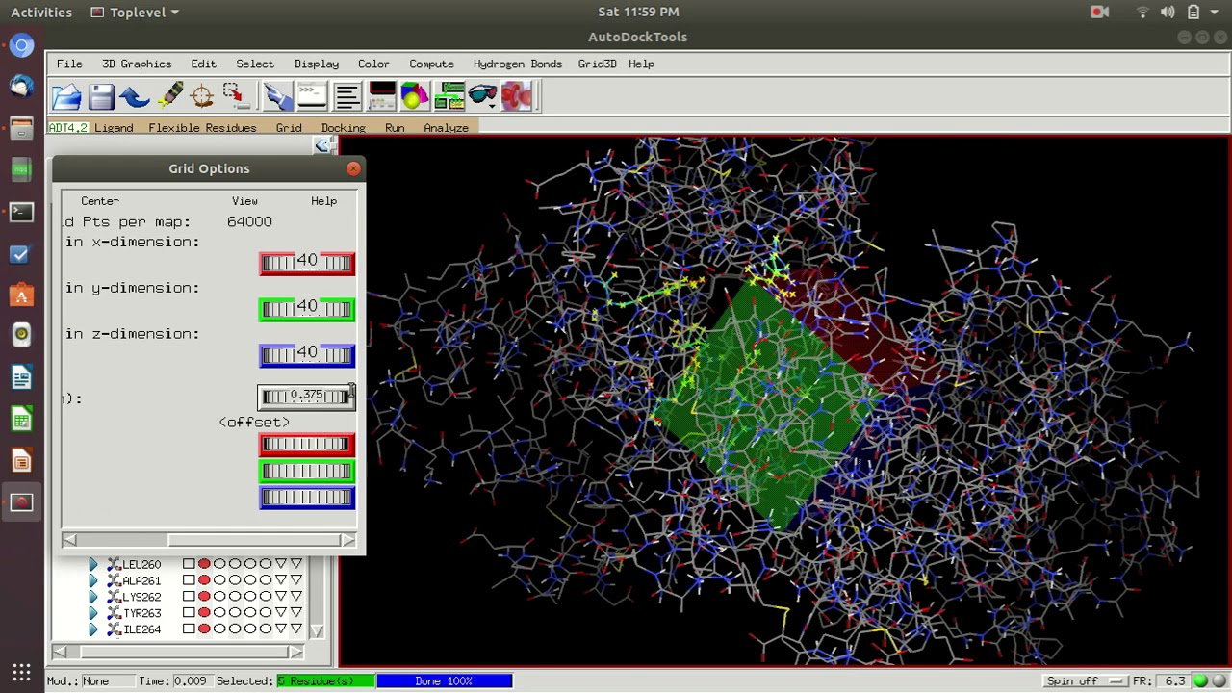
Small molecule docking
AutoDock, one of the reasonable, complete, free programs for small molecule docking

Slide 6
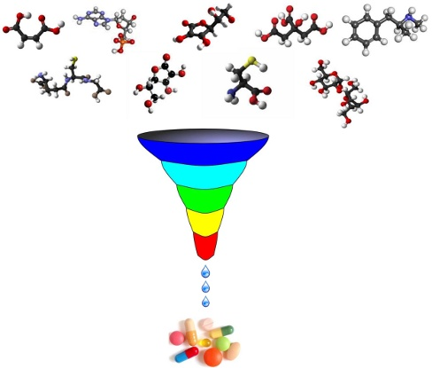
Small molecule docking for virtual screening
With good sampling + scoring for a given system, you can do virtual screening.
The goal is not to get *the* drug but to enrich a list in potentially good compounds, to target experimental assays and reduce time and money.
AIM: 1000 good in 10⁹ → 10-100 good in 10³ -10⁴
Then do exps on 10³ - 10⁴ not 10⁹ compounds
These are often just leads to be optimized later on (for potency, selectivity, and ADME* properties)
* ADME= absorption, distribution, metabolism and elimination

Slide 7
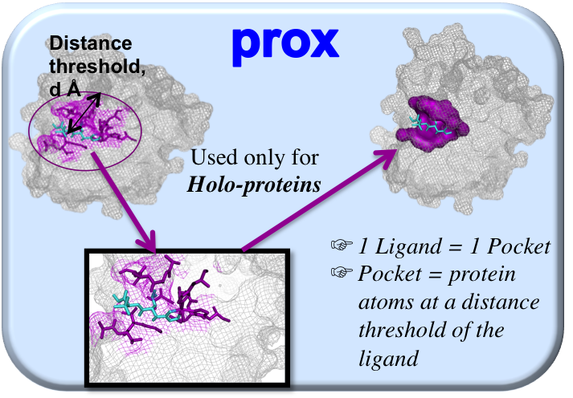
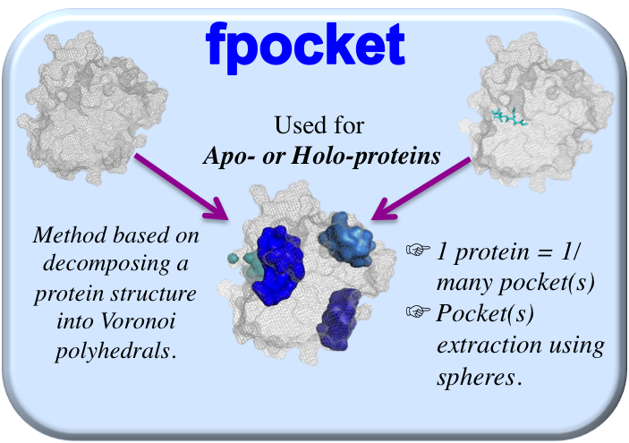
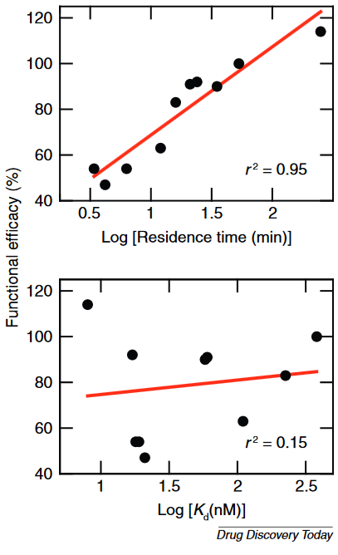
Small molecule docking / Virtual screening, some more notes
2) It’s now trendy to reveal “cryptic” pockets by MD, then try to make drugs that bind to them
1) You first need to know your target, allosterism, etc. and find and druggable pockets
3) Off-rates are gaining relevance over thermodynamic affinity. You can measure this quite well with accelerated MD
Pan … Shaw Drug Discovery Today 2016

Slide 8
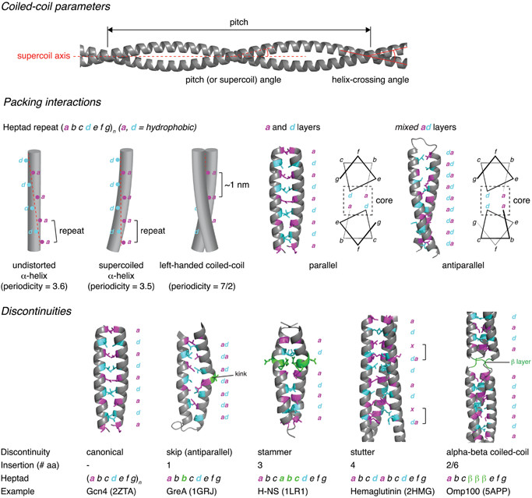
Canonical protein structures (secondary structures, coiled coils, …)
α-helices and β-strands right inside PyMOL --by hand or with for aa in "DCAHWLGELVWCT": cmd._alt(string.lower(aa))
--assist this with sequence predictions et al
Coiled-coils --CCBuilder2: https://onlinelibrary.wiley.com/doi/full/10.1002/pro.3279
-- By D.N. Wolfsson, one of the “Masters of CCs”
--Two more masters are G. Grigoryan, W. F. DeGrado: https://grigoryanlab.org/cccp/
--Another good read: https://onlinelibrary.wiley.com/doi/full/10.1002/bies.201600062
-- For predictions from sequence: http://cb.csail.mit.edu/cb/multicoil2/cgi-bin/multicoil2.cgi

Slide 9
Protein-X complexes
Surface predictions: PESTO and dMaSIF both @ EPFL
AF2-multimer: To “co-fold” two or more interacting proteins (ColabFold) / See Baker’s database for eukas
MoRFs (molecular recognition features) and SLiMs (short linear sequence motifs) in disordered proteins/regions. Among the lots of tools I like IUPRED to detect disordered regions and tools by Jörg Gsponer for actual prediction of binding sites
Most-studied MoRFs/SLiMs: -- Signal peptides, localizations signals (NLS, NES, mitochondrial, etc.).
-- Specialized predictors, databases, and papers.
-- Often can model based on the predictions. Ex. for NLS in next slide

Slide 10
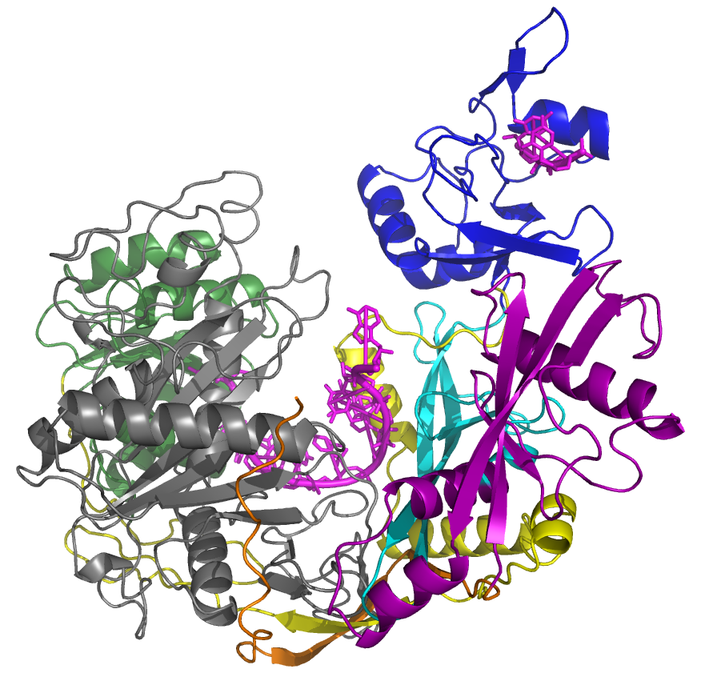
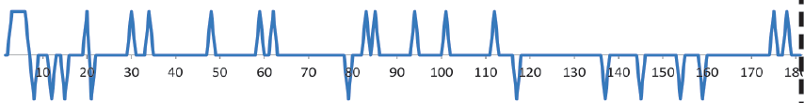
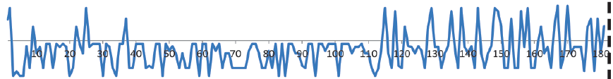
Protein-X complexes: Example of functional MORF, sequence predictions, and modeling
NtD+ (disordered, mostly positive)
Ntd- (orderable, mostly negative)
Charge
NLS
NES
Argonaute 1: processing of non-coding RNAs
PAZ
Hydrophobicity
DUF1785
MID
Predicted and validated NES:
TQVPEPTVLAQQFEQLSVEQGAPSQAIQPI
Structure of similar peptide bound to Exportin-1 at
https://www.rcsb.org/structure/2l1l
Concept of “folding upon binding”.
AF-multimer to predict interaction between NES and the exportin protein
PIWI
L2
N-domain
N-terminal (starts Ser172)
Side note: It’s always worth looking at sequences yourself!

Slide 11
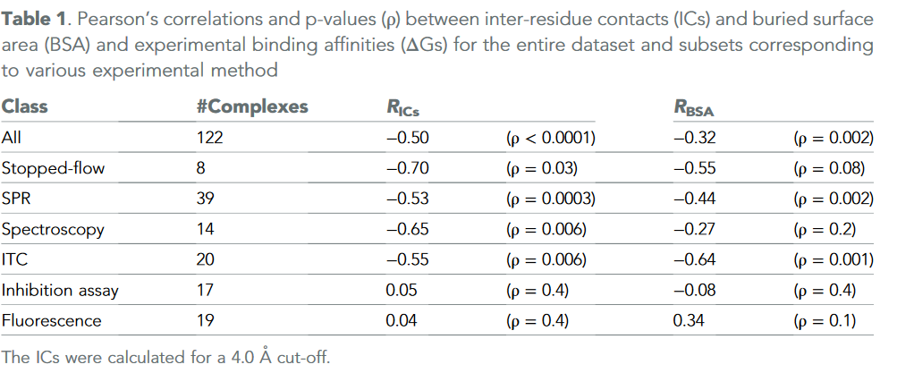
Protein-X complexes
Protein-X Docking: Purely predicted or informed with data
Z-Dock, HADDOCK HADDOCK, others
Check CAPRI (~CASP for complexes)
Note that “data” is not only experimental
Conservation vs. Variation (Protein-protein coevolution)
See https://gremlin2.bakerlab.org/ and https://elifesciences.org/articles/02030 (for ex. Fig. 2)
Of course chemical/physical sense, but this is usually considered by the docking method itself.
The HADDOCK people further explore
other interesting points, like this one in →
https://elifesciences.org/articles/7454

Slide 12
Membranes, micelles, liposomes, etc.
Glycans, glycolipids
Polymers
CHARMM-GUI website
  To setup models
  And parametrize them for simulations
…etc.

Slide 13
Molecular modeling / simulations
Molecular Modeling = building a (physical or intangible) representation of a molecule
Quantum, classical atoms, coarse-grained -- In silico, on paper, in your hands…
Based on experimental data, computer calculations, knowledge + intuition, etc.
Even “experimental” structures are actually models!
Molecular Simulation = propagation of a model over time, scales, etc…
…through computer calculations but also in your mind or in your hands,
following data-based potentials, physical potentials, experimental data, knowledge + intuition
              F = electrostatics + bonds + angles + van der Waals + …
              A = F / m
              d(x,y,z) = (x,y,z) + v dt + 0.5 a dt²
              (x,y,z) @ t → (x,y,z) @ t+dt

Slide 14
3 – Modeling and (vs.) simulation
Molecular Modeling = building a (physical or intangible) representation of a molecule
Quantum, classical atoms, coarse-grained -- In silico, on paper, in your hands…
Based on experimental data, computer calculations, knowledge + intuition, etc.
Even “experimental” structures are actually models!
Molecular Simulation = propagation of a model over time, scales, etc…
…through computer calculations but also in your mind or in your hands,
following data-based potentials, physical potentials, experimental data, knowledge + intuition
              F = electrostatics + bonds + angles + van der Waals + …
              A = F / m
              d(x,y,z) = (x,y,z) + v dt + 0.5 a dt²
              (x,y,z) @ t → (x,y,z) @ t+dt

Slide 15
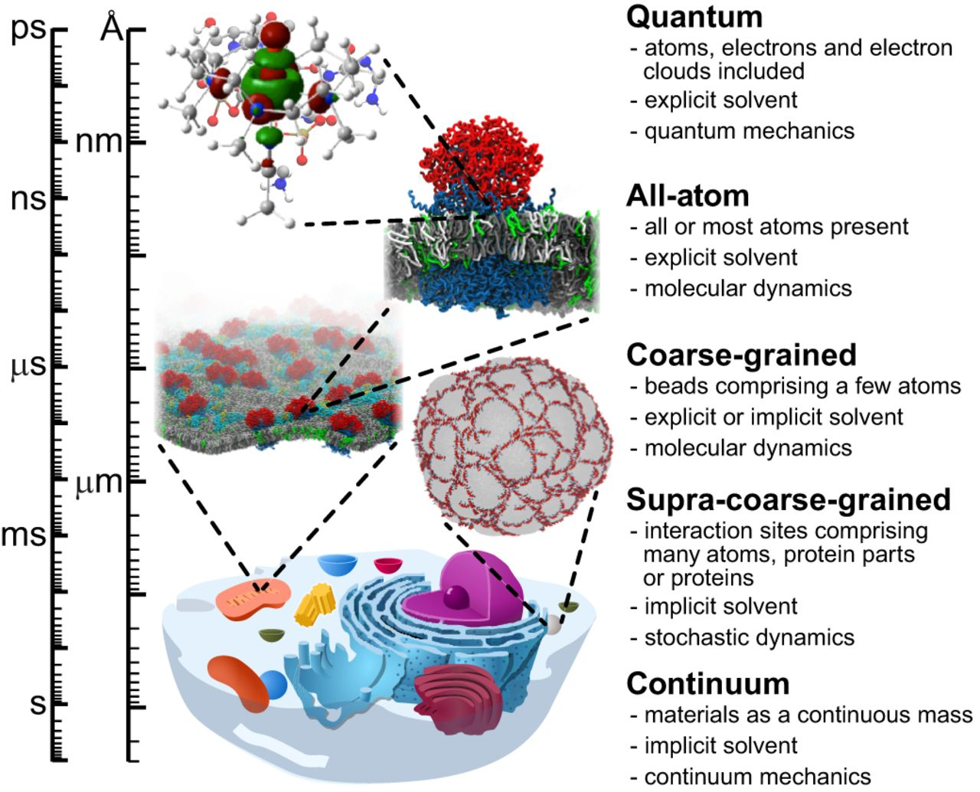
Models of different “resolution” or “granularity”

Slide 16
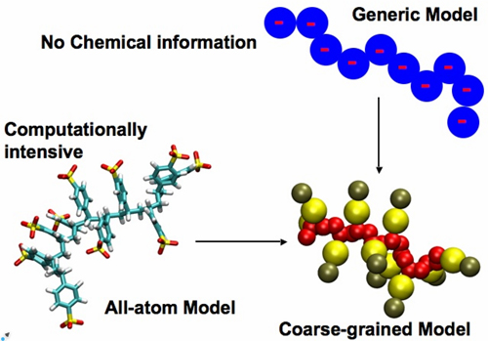



Models of different “resolution” or “granularity”
All-atom forcefields
AMBER, CHARMM
Coarse-grained forcefields
MARTINI, SIRAH
Website to prepare systems for simulation with CHARMM36m, MARTINI and other force fields.
Load PDB file and follow steps to create topologies
Download files and run in amber, gromacs, namd, etc.
Highly recommended but only if you know what you are doing or you just want to view your system

Slide 17
In principle, fully physics-based simulations have the potential to tell you everything
Reactions and spectroscopy (Quantum Mechanics! –very special expertise)
Folding of small proteins (only for small proteins and with a lot of sampling)
For ex. https://www.youtube.com/watch?v=gFcp2Xpd29I
Protein-protein/membrane/nucleic acid/small molecule interactions (CG…)
Binding of substrates and ligands to protein (multiple replicas)
For ex. https://www.youtube.com/watch?v=V0Z52u8h2es
Hydration dynamics (well sampled, because water moves fast)
Functional motions (ok for small rearrangements, but not for conformational changes)
But often at a huge cost: as you see many problems are out of reach in practical terms!
Therefore data/knowledge-based methods most of the time offer better options! (e.g. AF2)

Slide 18
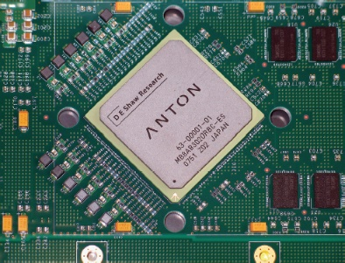
That MD simulations are very limited doesn’t mean there’s no interest in them
Special tools such as:
- MD in specialized computers like Anton
- Replica-exchange and similar MD methods
Biased enhanced-sampling MD methods (…)
AI-based methods for exploring protein conformations (Noe @ Microsoft among others)
DE Shaw Res.

Slide 19
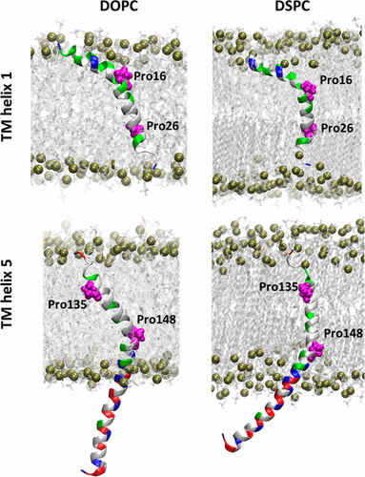
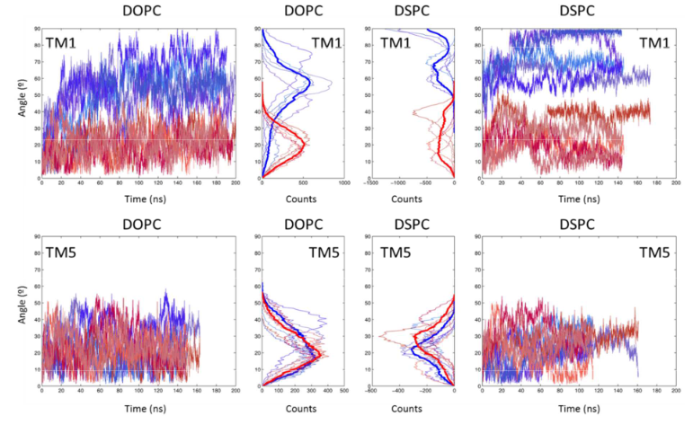
When systems and questions are well posed, MD helps
Example: Understanding protein – membrane mechanics with atomistic detail
Abriata et al Accounts Chem Res 2017
Fernandez et al mBio 2019

Slide 20
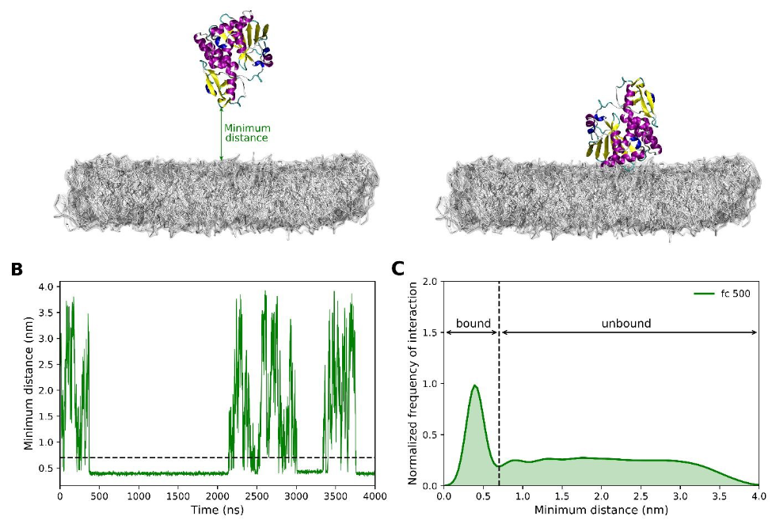
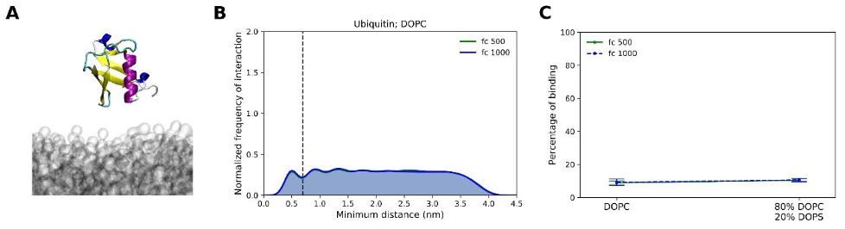
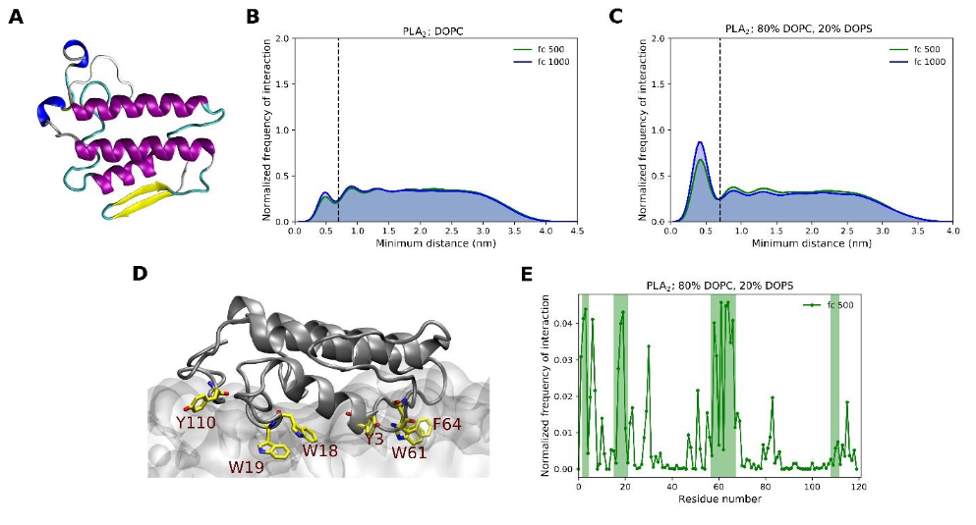
When systems and questions are well posed, MD helps
Membrane association with a MARTINI description
Srinivasan et al Faraday Disc. 2020

Slide 21
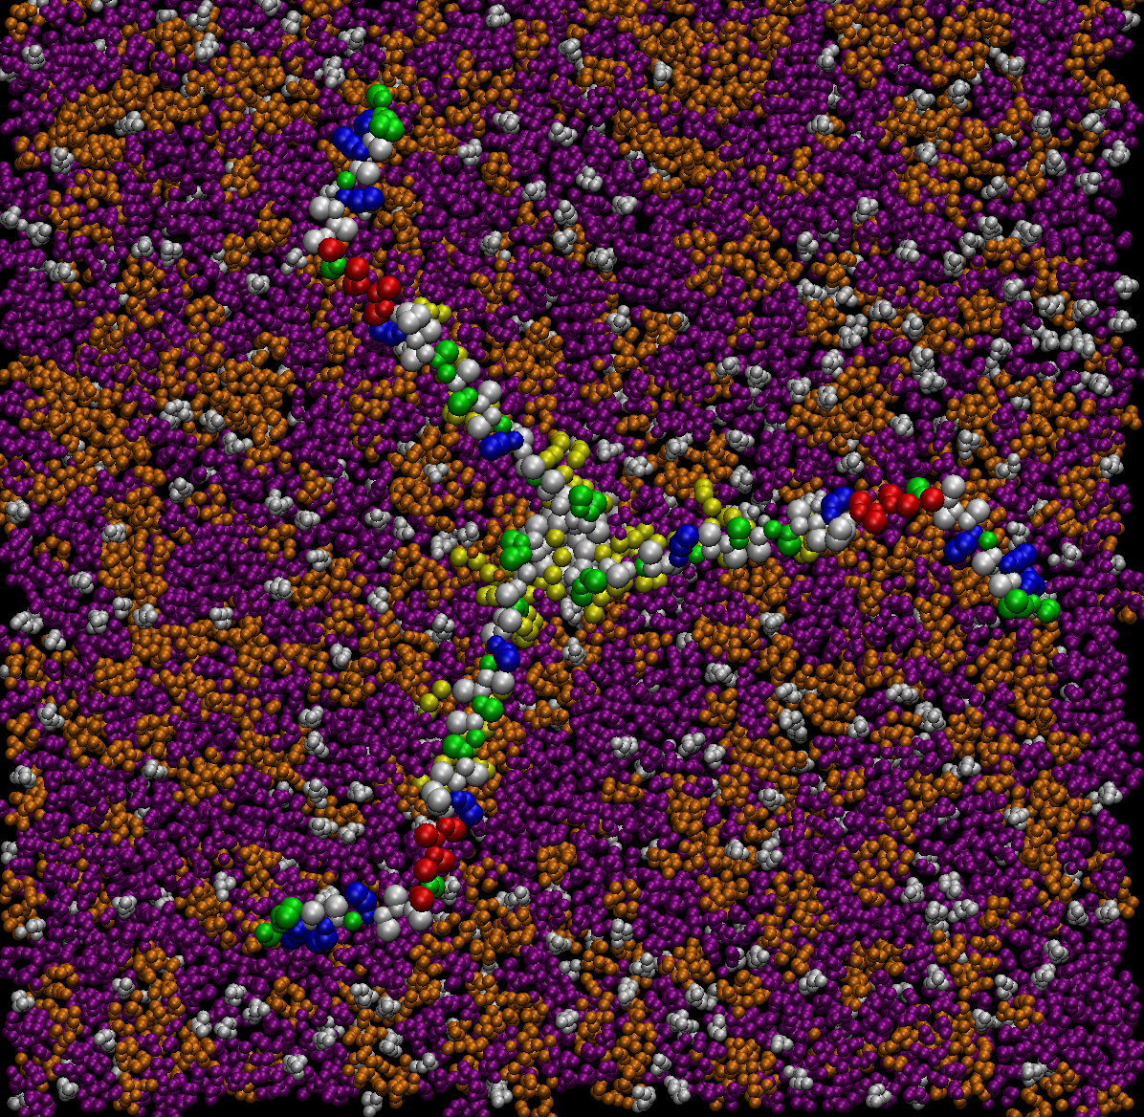
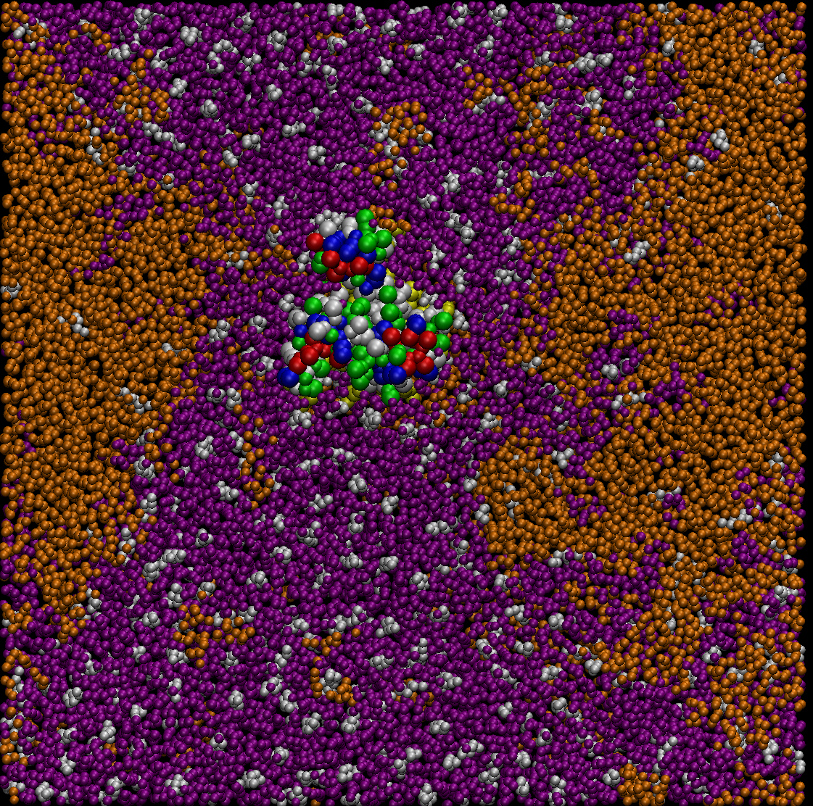
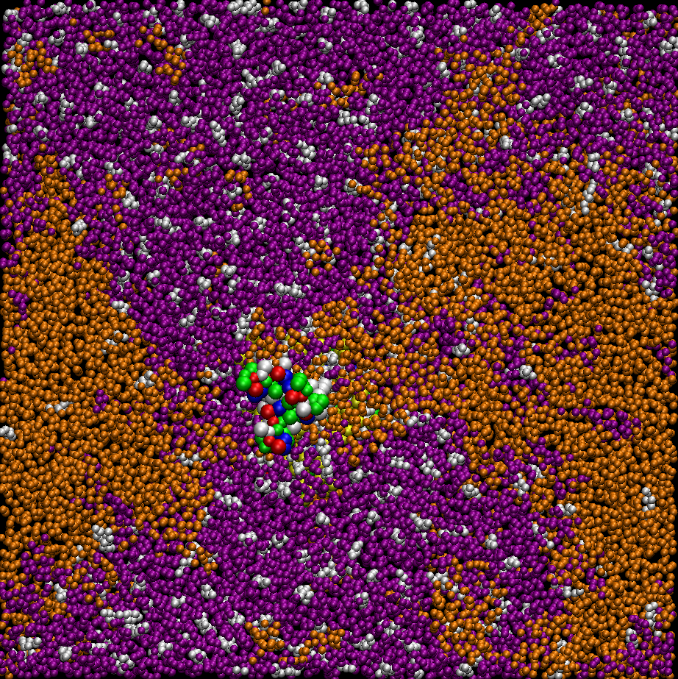
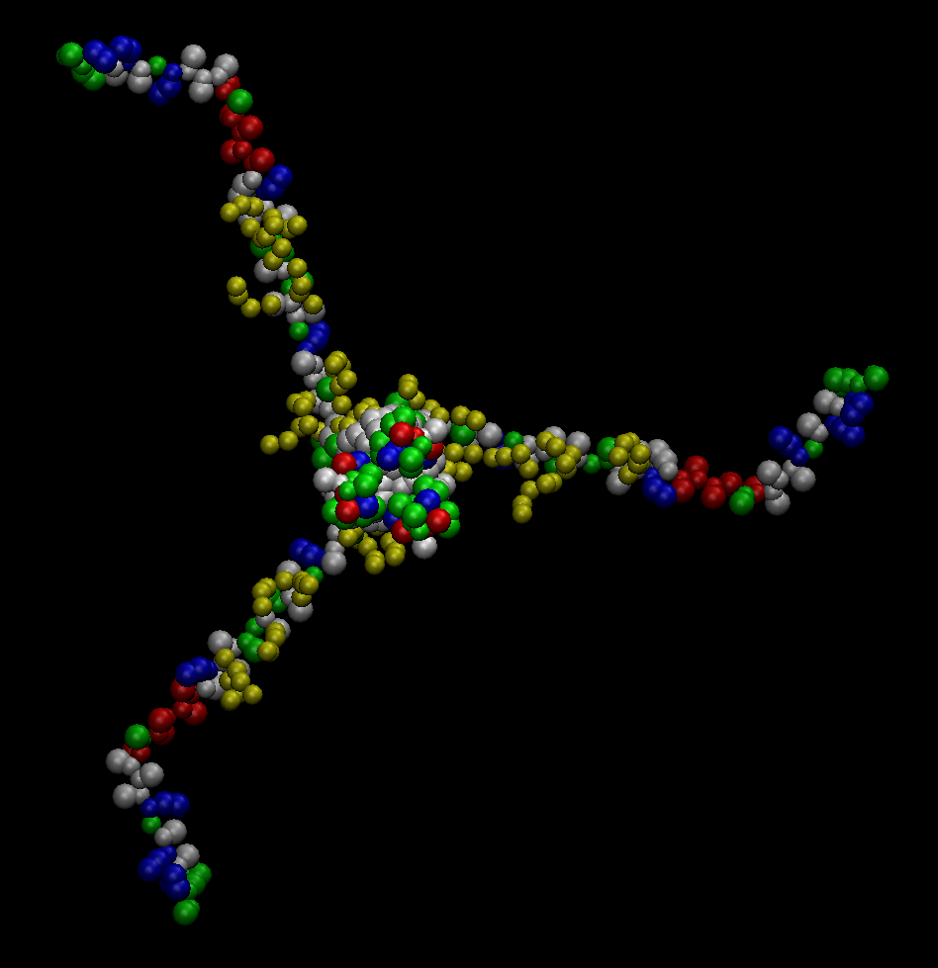
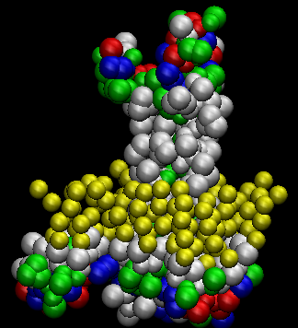
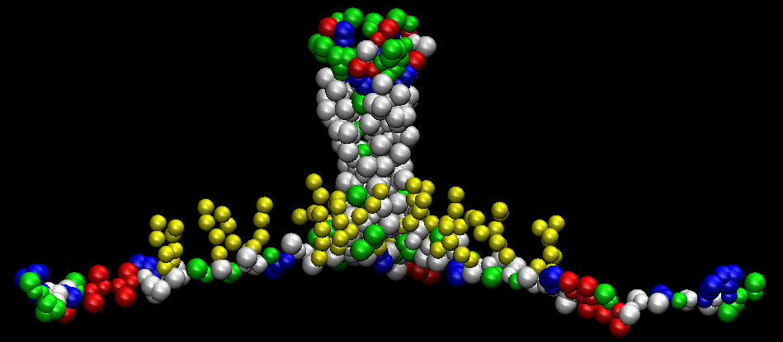
When systems and questions are well posed, MD helps
Lipid partitioning into rafts, and partition of a protein into it
Setup with lipids distributed randomly
DPPC (fully sat.)
DLiPC (2 insats.)
Cholesterol
DPPC (fully sat.)- Cholesterol phase (Lo)
Views from inside
DLiPC phase
140k beads ~ ½ - ¾ million atoms
So far 3 us
(in CG)
23 nm
View from outside
23 nm
outside
outside
3.5 nm
Polar AAs
Hydrophobic AAs
Negative Positive
Palmitoylated cys
inside
inside

Slide 22
Proposed problems
Build a model of a 10 mM solution of ubiquitin in a box of around 100x100x100 Å³. Consider all-atom, coarse-grained, or hand-drawn models. And make it smooth when projected into infinite copies!
Then:
  - Estimate the average distance between centers of mass
  - Estimate the minimal surface-surface distance
2) Build a model of a 600 amino acid protein for which:
- Sequence predictions say fully helical secondary structure, w/ TM + coiled coil
- Exps with the coiled coil domain show it is all dimeric
Then:
- How far away from the membrane does the coiled coil project?
- Design an exact sequence that could form a “perfect” called coil (check papers and PDB structures)
- How can you introduce flexibility halfway in the coiled coil part?
https://onlinelibrary.wiley.com/doi/full/10.1002/pro.3279

Slide 23
Build a model of a 10 mM solution of ubiquitin in a box of around 100x100x100 Å³. Consider all-atom, coarse-grained, or hand-drawn models. And smooth when projected into infinite copies!
Then:
  - Estimate the time/space-average distance between centers of mass
  - Estimate the time/space-averaged surface-surface distance
Maximum concentration of a soluble protein in vitro is in the order of 10 mM
0.01 M → 6.0221E+21 protein molecules … in 1 liter = 1E-3 m³ = 1E27 Å³
Dividing by 1E21 … 6.0221 molecules … in 1E6 Å³ = 100 x 100 x 100 Å
Or … 8 molecules in 133 x 133 x 133 Å
Diameter of ubiquitin is 22 Å, therefore
P-P surfaces will be 44.5 Å away in average…
(Disregards shape, random encounters through diffusion and any possible affinity for association, but allows you to visualize scales!)
133 → 66.5
133 → 66.5

Slide 24
Proposed problems (adapt to your cases of interest)
Take a transmembrane protein and embed a structure or model of it in membranes of different thicknesses.
- Check hydrophobic match/mismatch.
- Anticipate tilting and other properties
2) Play with more exotic molecules and materials. For example…
- Use LPS modeler to model lipo-polysaccharides and compare a few to regular membrane proteins
- Create polymers of EG (PEG), sugars, etc. and inspect their shapes / flexibility (the latter requires MD)
- Create nanotubes with varied parameters and compare to other molecules
- Create some “hard” materials of interest.
- Create nanoparticle mimics.

